Slide 1



INTRODUCTION TO LAMBDA & API-GATEWAY

Slide 2

Agenda
What is AWS Lambda.
AWS Lambda Pricing.
Programming Model.
What is API Gateway.
Lifecycle of API Request.
Use Cases

Slide 3
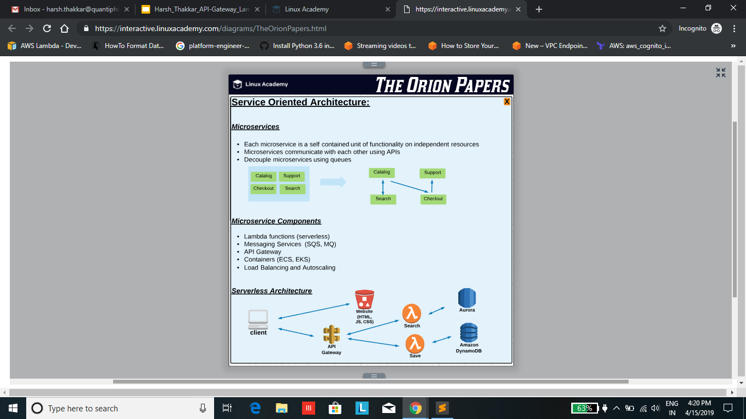
Introduction

Slide 4
What is AWS Lambda?
AWS lambda is a Compute Service where you can upload your code and create a Lambda Function.
AWS Lambda takes care of managing the servers that you use to run the code, you don’t worry about the O.S. Scaling, Hardware etc.
You Can use Lambda in following Ways:
Event-driven Compute Service where AWS Lambda runs your code in response to events.
Compute Service to run your code in response to HTTP requests using Amazon API Gateway or API calls made using Amazon SDKs.

Slide 5
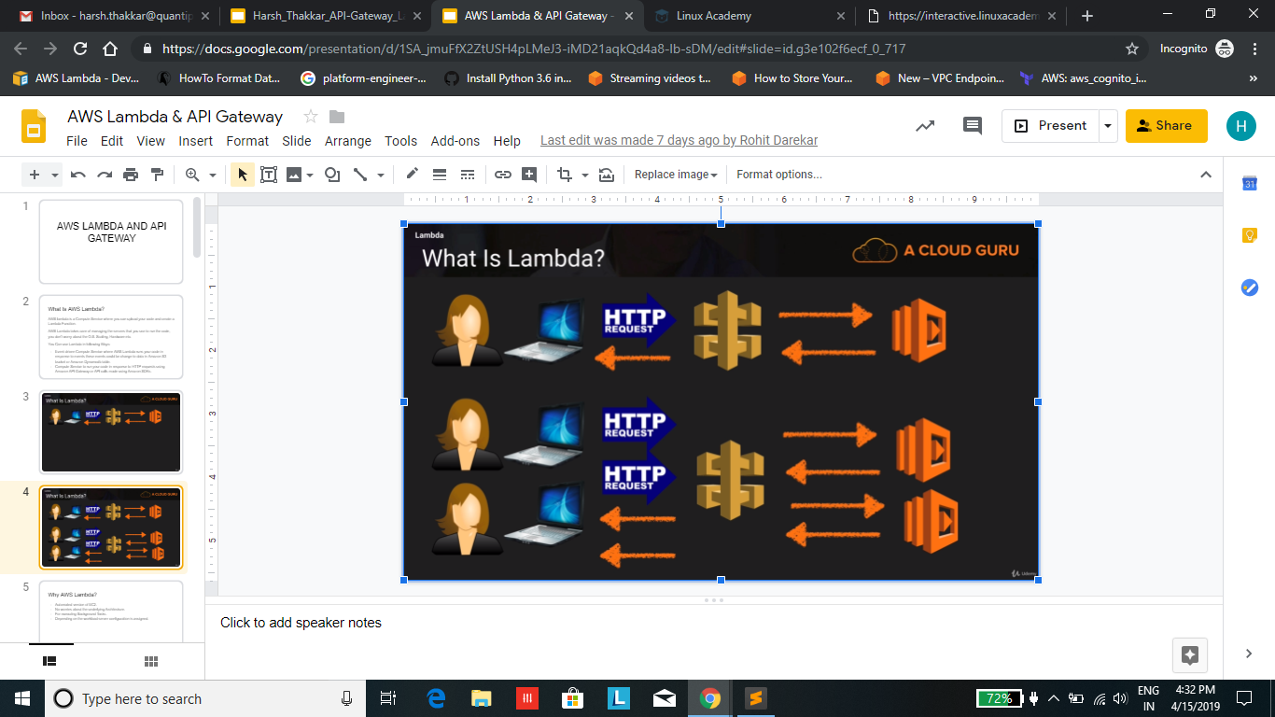

Slide 6
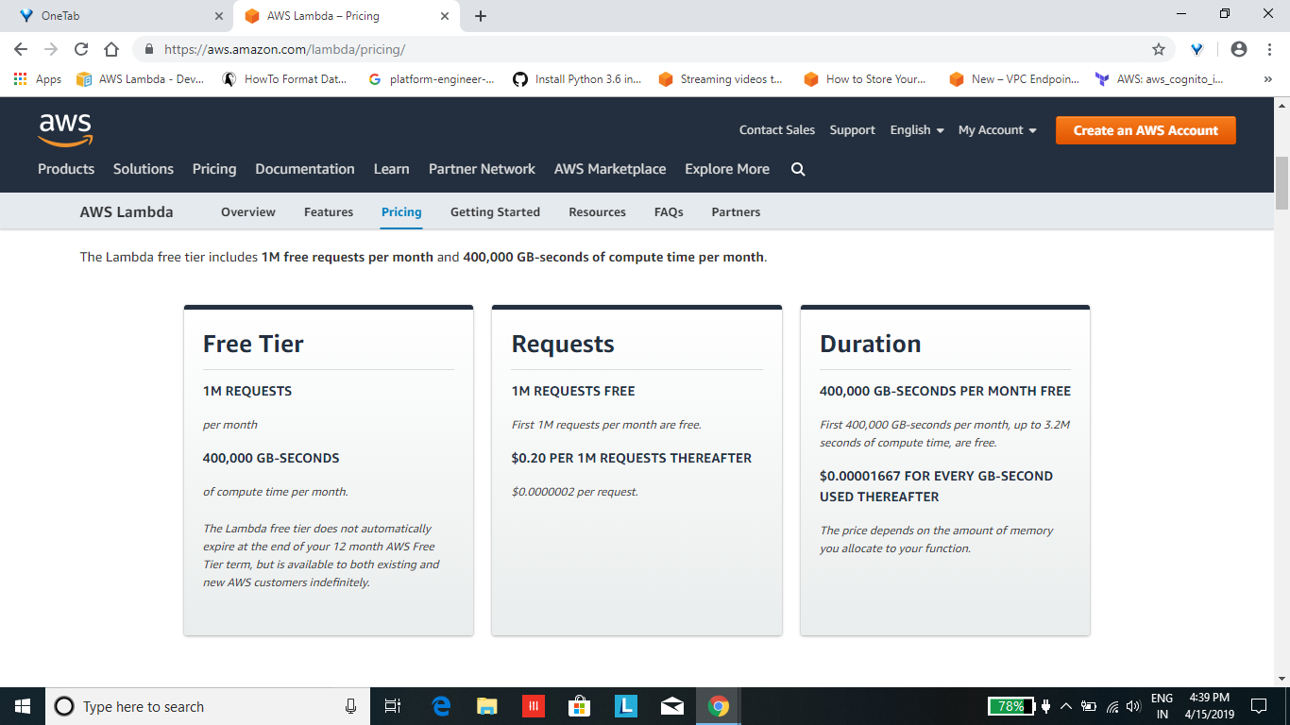
How Lambda Priced?

Slide 7
Programming Model
Handler
Handler is the function which AWS Lambda calls to start execution of your lambda function.
When a Lambda function is invoked. AWS Lambda starts executing your code by calling the Lambda function.
AWS Lambda passes any event data to this handler as the first parameter.
Your handler should process the incoming event data and may invoke other functions or methods in your code.
def handler_name(event, context):
return Some_Value

Slide 8
Programming Model Cont..
Event: - AWS Lambda uses this parameter to pass in event data to the handler. This parameter is usually of Python dict type.
Context: - AWS Lambda uses this parameter to provide runtime Information to your Lambda.

Slide 9
Features & when to use Lambda over EC2
Features :-
Automated version of EC2.
No worries about the underlying Architecture.
For executing Background Tasks.
Depending on the workload server configuration is assigned.
2. When to use Lambda over EC2 :-
Changes to Amazon S3 Bucket.
SQS Queue.
Updates to Amazon Dynamodb Table.
Kinesis Stream.

Slide 10
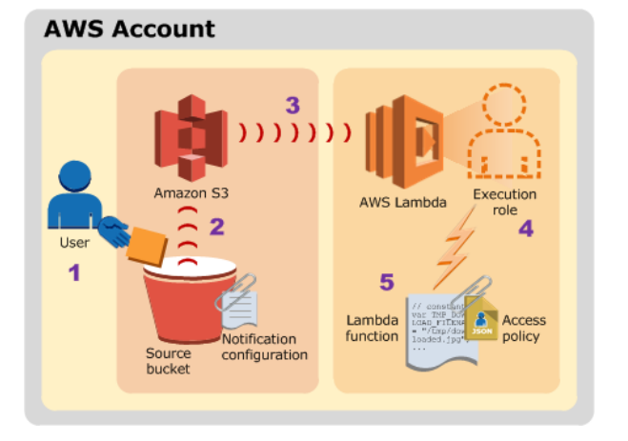

Slide 11
API Gateway

Slide 12
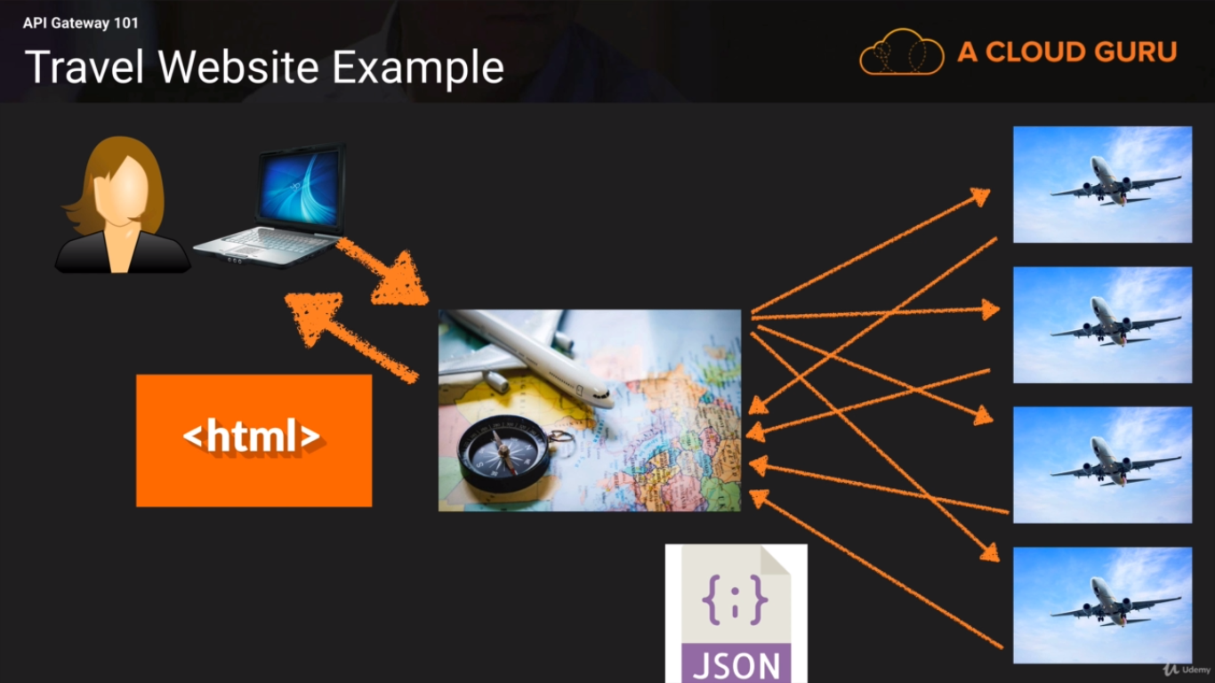

Slide 13
What is API Gateway?
Amazon API Gateway is a fully managed service that makes it easy for developers to publish, maintain, monitor and secure APIs at any scale.
With a few clicks in AWS management console, you can create AP that act as “front door” for application to access data, business logic, or functionality from your back-end service, such as application running on EC2, code running on Lambda, or any web application.

Slide 14
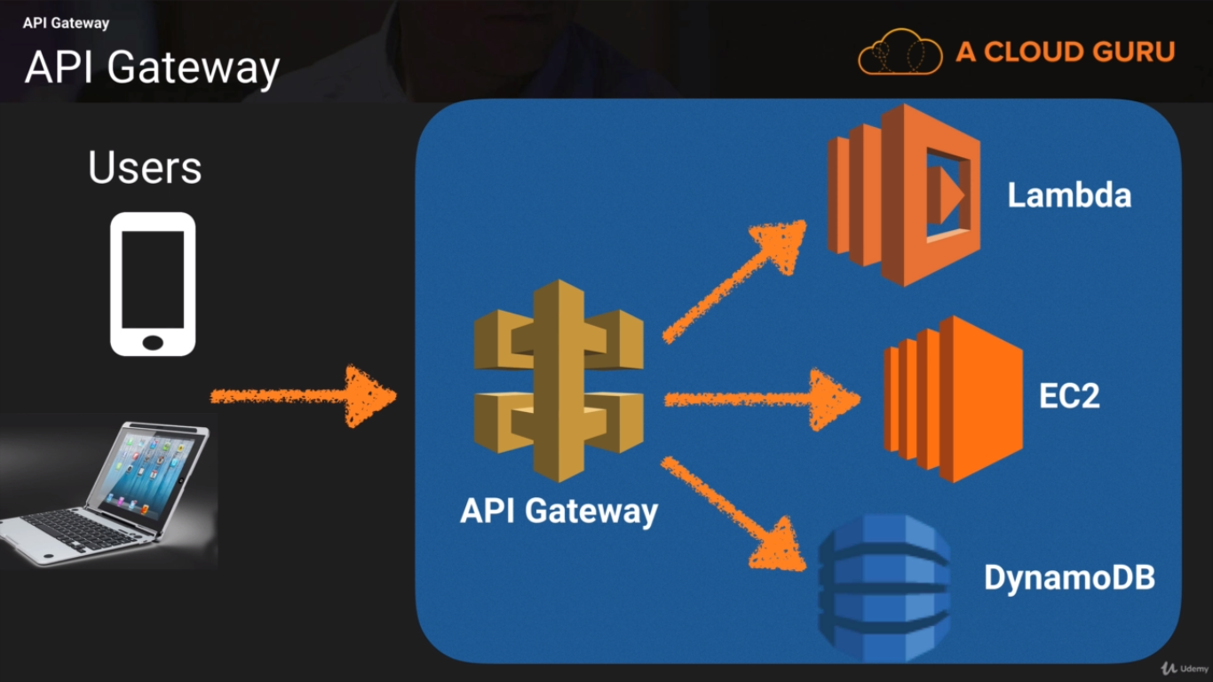

Slide 15
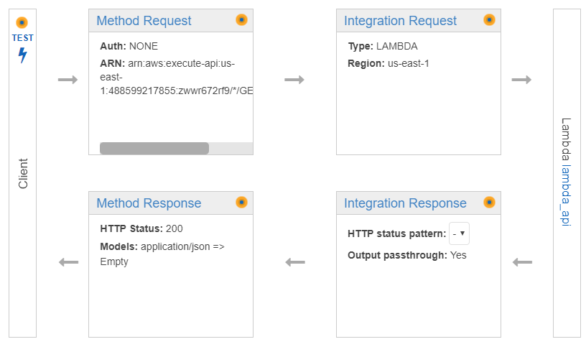
Lifecycle of API Request.

Slide 16
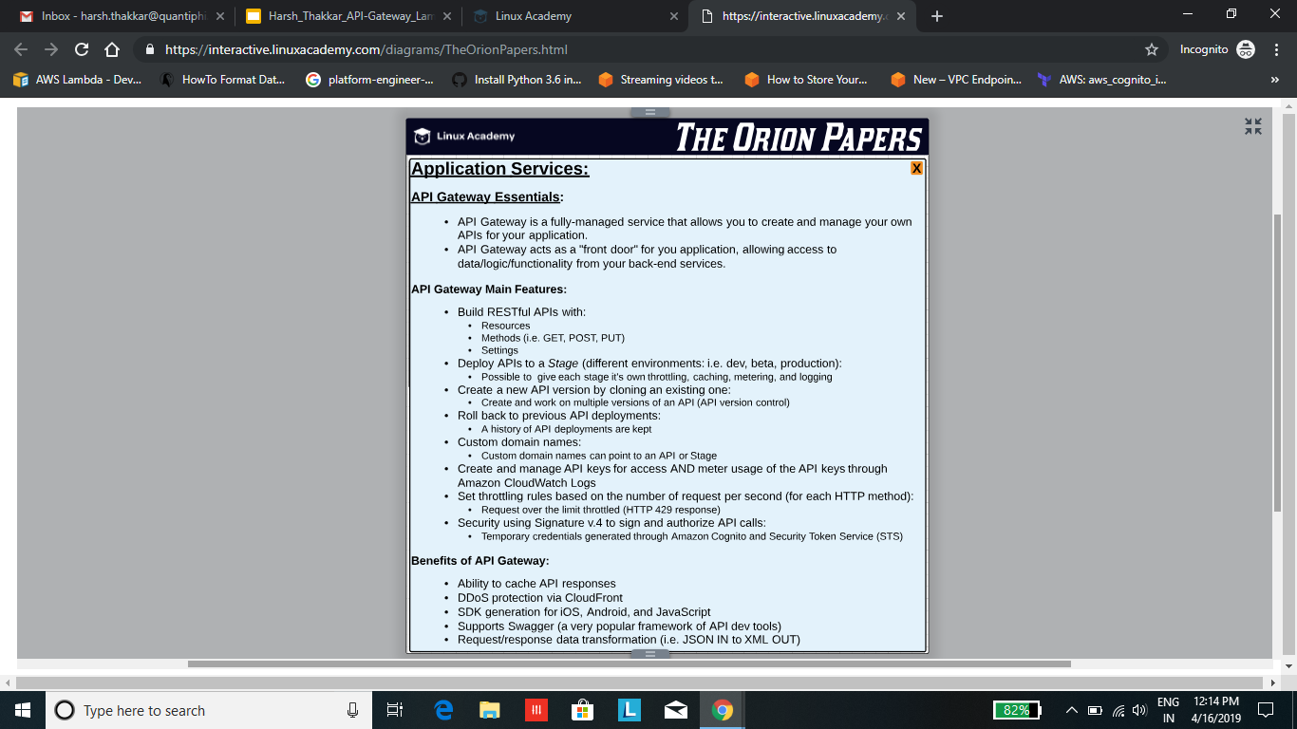

Slide 17
Benefits of Api
Ability to cache API Response.
DDoS prevention via cloudfront.
Supports swagger.
Request/response data transformation (i.e. JSON IN to XML OUT)

Slide 18
USE CASES

Slide 19
Use Cases
Operating serverless websites (PAQt - paqt.quantiphi.com)
Log analysis on the fly (from cloud trail or cloud watch)
Automated backups and everyday tasks
Processing uploaded S3 objects
Filtering and transforming data on the fly

Slide 20
THANK YOU

